Slide 1

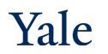
Generative Models, Distribution Distances and GANs
CPSC 452/552
CBB/AMTH 663

Slide 2
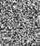
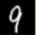
Generative Models
NNet
Noise
Something “like” training sample
Notes:
Visualization of samples from the model. The rightmost column shows the nearest training example of the column just to the left.

Slide 3
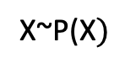
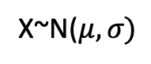
Probabilistic Interpretation
NNet
Randomly
Sampled
Noise
Sample from training Distribution
X~P(X$)$
X~N($μ,σ)$
Notes:
Visualization of samples from the model. The rightmost column shows the nearest training example of the column just to the left.

Slide 4
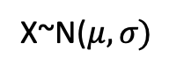
Generative Matching
Train a neural network with input stochasticity to mimic output distribution
Penalize by a distribution distance or divergence: KL divergence, MMD distance, wasserstein distance
NNet
Randomly
Sampled
Noise
Sample from training Distribution
X~P(X$)$
X~N($μ,σ)$

Slide 5
Outline
Distances and divergences between distributions
MMD net
GANs
WGANs

Slide 6
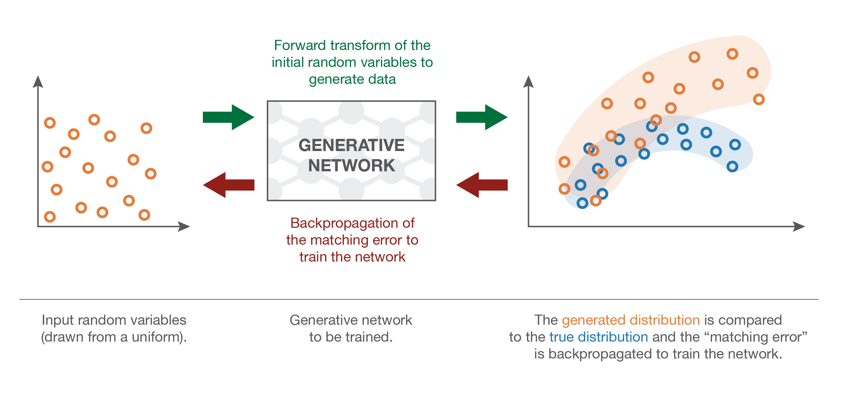
MMD Net

Slide 7
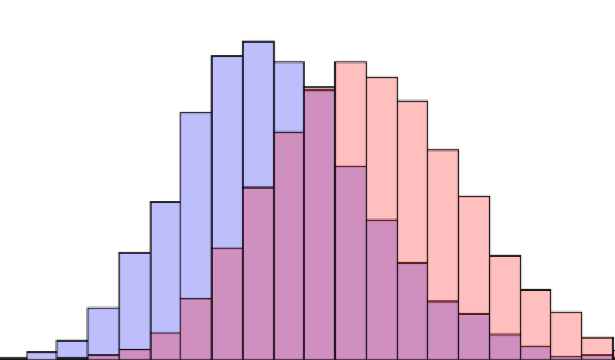
Maximum Mean Discrepancy
[Dziugaite, Roy, Ghahramani, UAI 2015]

Slide 8
MMD nets
Train the neural network to transmute noise into desired probability distribution using Maximum Mean Discrepancy optimization. [Dziugaite et al. 2015]
MMD is a kernel-based 2-sample distribution test for distribution similarity
Problem: This is a batch-level penalty, penalize a whole batch to look like the training distribution

Slide 9
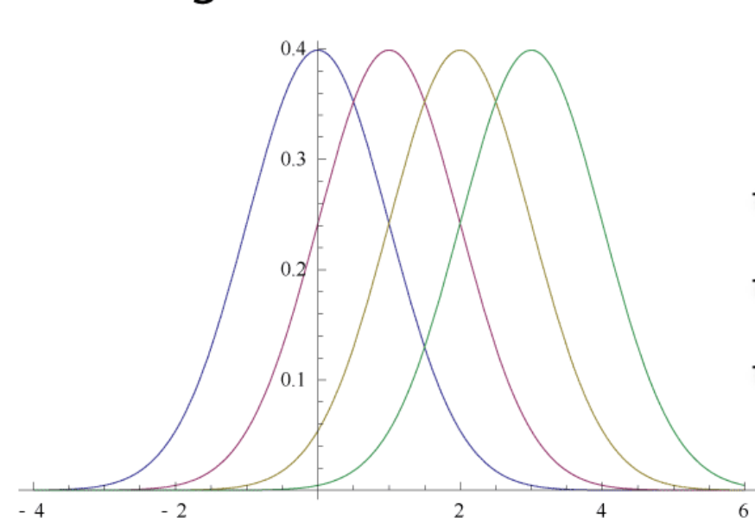
Can we just measure pointwise L1 distance ?
Why not?
What is considered more, areas of high density or low density?

Slide 10
Ways of Comparing Probability Distributions
Cross Entropy
Divergences
KL divergence
Jensen-Shannon Divergence
Distances
Earth Mover’s Distance (Wasserstein distance)
Maximum Mean Discrepancy

Slide 11
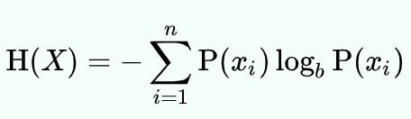
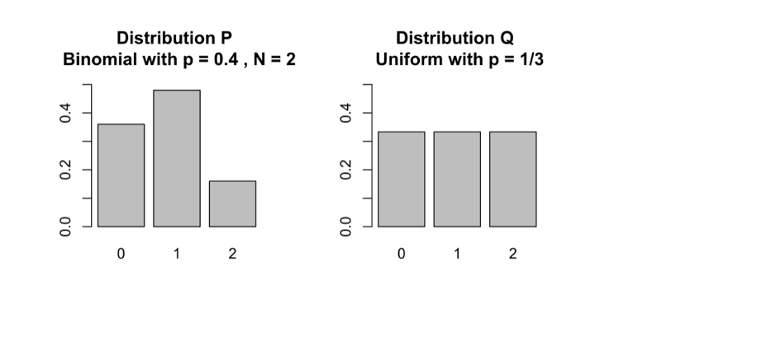
Recall: Entropy
The expected amount of uncertainty in a distribution
Given by
That is the amount of information you learn by knowing the solution

Slide 12
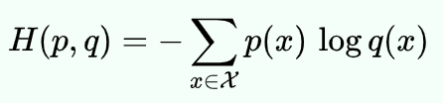
Cross Entropy
Given 2 distributions P and Q
How many bits on average does it take to “encode Q” in a code that is optimized for P
Notes:
Have the class do this exercise.

Slide 13
Encoding a distribution Q
For instance, if you had 3 outcomes A, B, C,
q(A)=1/2
q(B)=1/4
q(C)=1/4
You could encode:
A as 1
B as 11
C as 10
This ensures short messages for communication
Average number of bits needed is (1/2)*2+(1/2)*1 = 1.5

Slide 14
Suppose you used encoding for Q on distro P
P is distributed differently than Q
p(A)=1/4
p(B)=1/4
p(C) = 1/2
Now what is the average number of bits needed?
Average bits needed = (3/4)*2+(1/4)*1 = 1.5+.25=1.75
Using Q‘s code to transmit P takes more bits

Slide 15
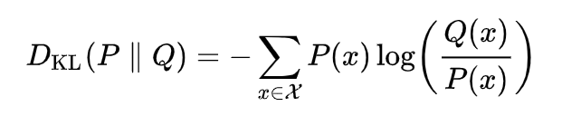
KL Divergence
Expected number of EXTRA bits needed if using samples from P on a code optimized for Q
Related to cross entropy, also called relative entropy
Note that this is just H(P,Q)-H(P)

Slide 16
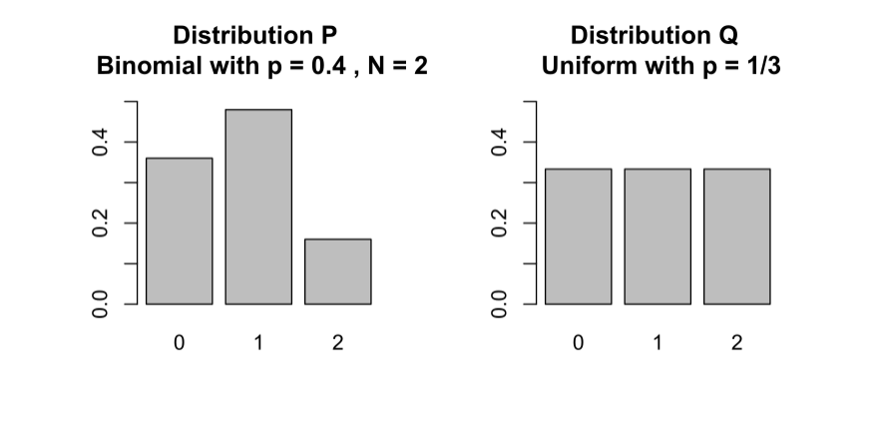
Example

Slide 17
Worm teeth example (from blog)

Slide 18
Which simple distribution better approximates this?
Each of these simple distribution has only 1 parameter to convey, N for uniform, and p for binomial

Slide 19
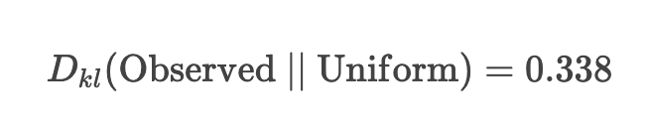
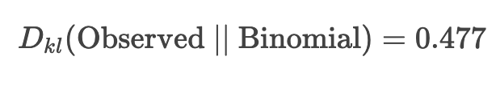
KL divergence of teeth distribution

Slide 20
KL Divergence is not a distance
Can this be a distance?
Is D(P||Q) same as D(Q||P)
What happens to areas when P is 0?
What about when Q is 0?
It also does not follow the triangle inequality

Slide 21
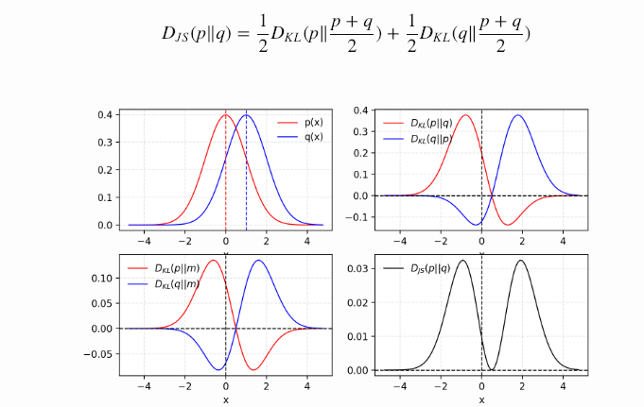
Jensen-Shannon Divergence

Slide 22
Earth Mover’s Distance
The EMD between two distributions is proportional to the minimum amount of work required to convert one distribution into the other.

Slide 23
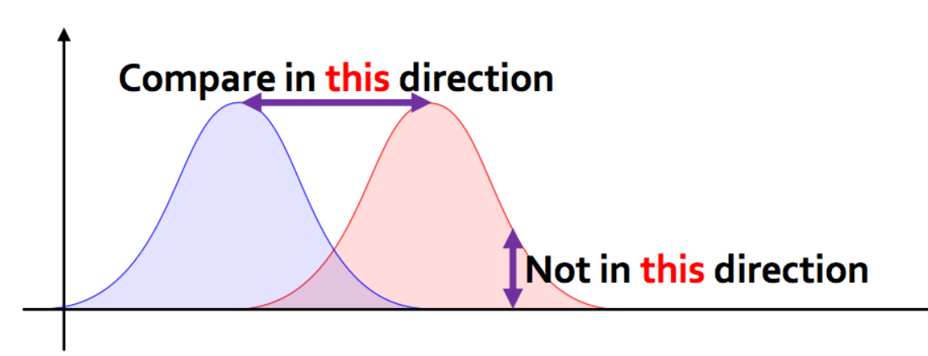
Key insight: Ground distance

Slide 24
Example

Slide 25
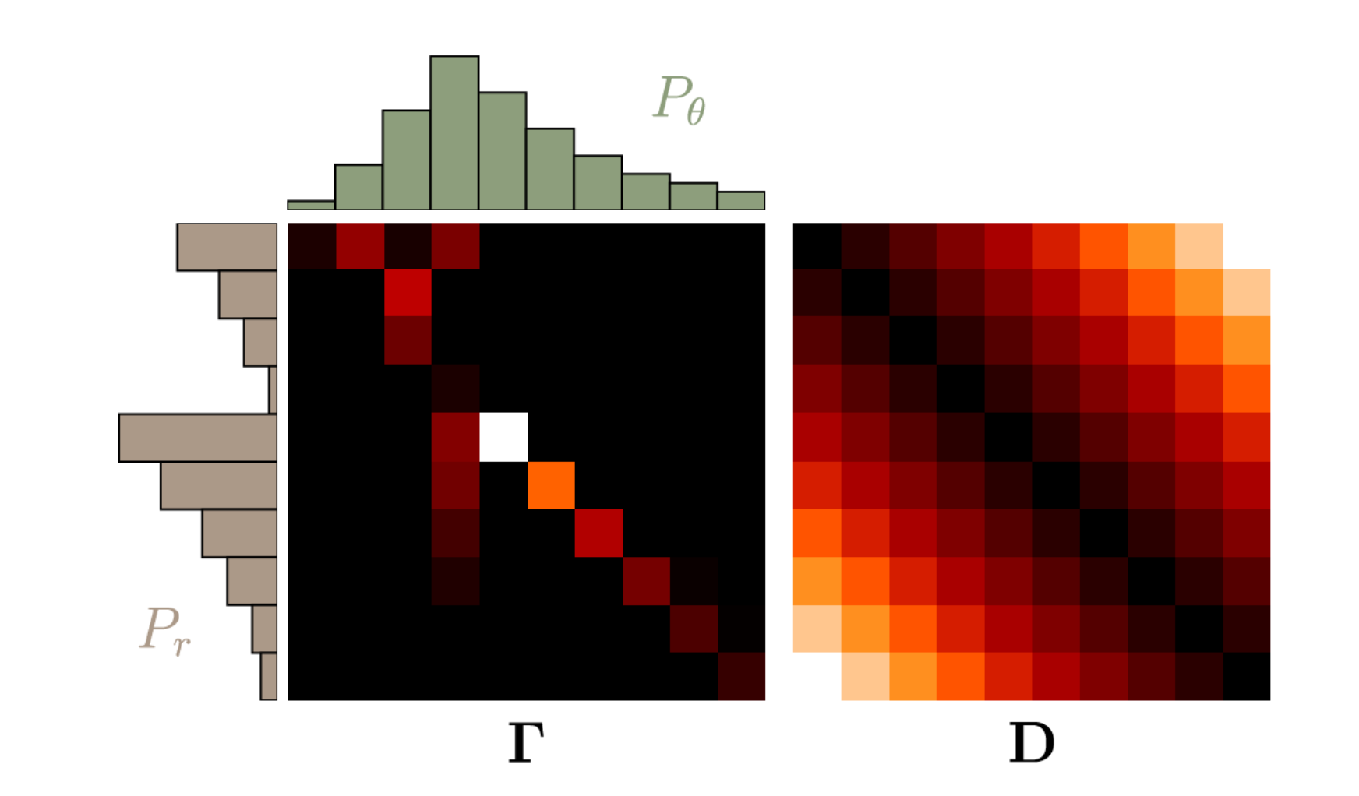
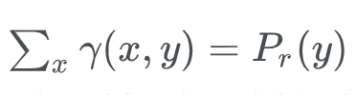
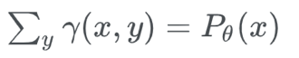
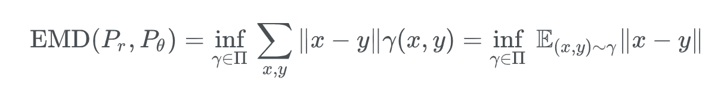
Valid Transport Plan
Marginals have to agree:
Object

Slide 26
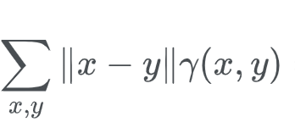
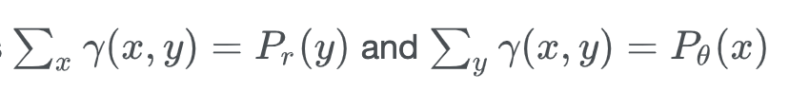
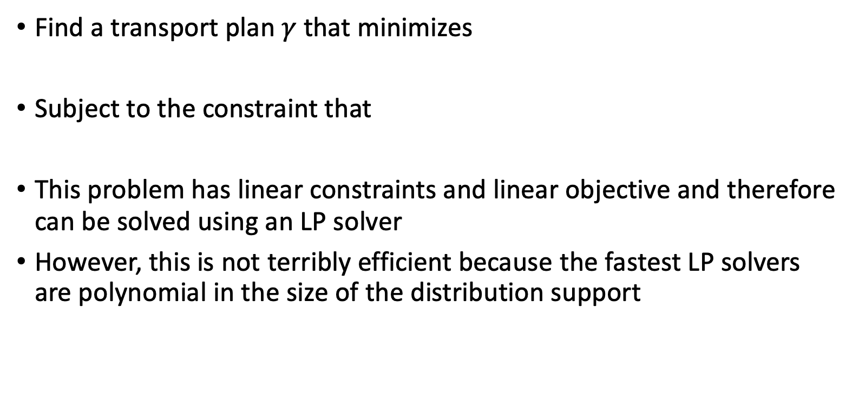
Linear Programming Solution
Find a transport plan $γ$ that minimizes
Subject to the constraint that
This problem has linear constraints and linear objective and therefore can be solved using an LP solver
However, this is not terribly efficient because the fastest LP solvers are polynomial in the size of the distribution support

Slide 27
Optimal Transport Plan

Slide 28
“Lifting” ground metric to the next level
Main advantage of EMD is that it “lifts” the ground metric which is defined point-to-point to a set of points
Can be used to compare datasets rather than datapoints
Images and documents are actually collections of points: pixels and words respectively

Slide 29
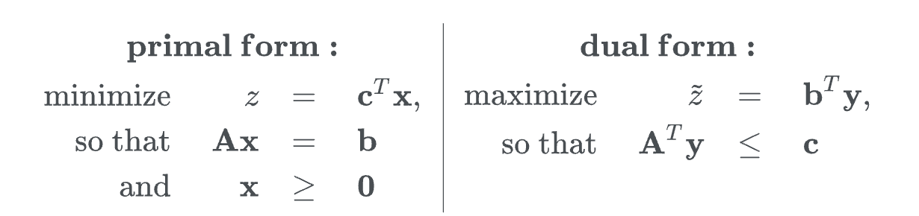
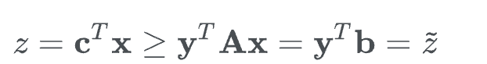
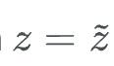
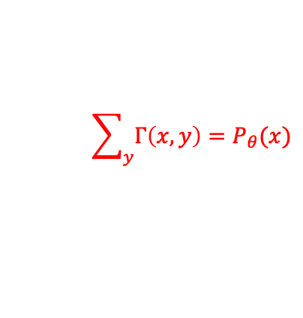
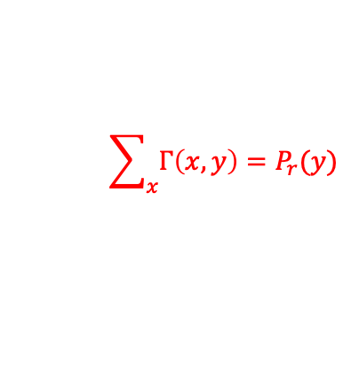
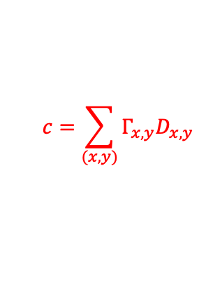
Dual of a linear program
Minimize
Here c is a vectorized form of D
x is a vectorized form of Γ
$$c=\sum_{(x,y)}{Γ_{x,y}D_{x,y}}$$
Weak duality:
A sums up the correct entries of x
and ensures its equal to marginal
$$\sum_{x}{Γ\left(x,y\right)=P_{r}(y)}$$
$$\sum_{y}{Γ\left(x,y\right)=P_{θ}(x)}$$
Strong duality:

Slide 30
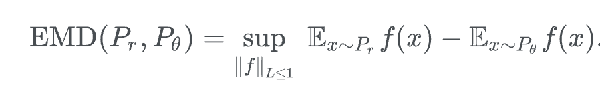
Dual Form of EMD: Witness Function

Slide 31
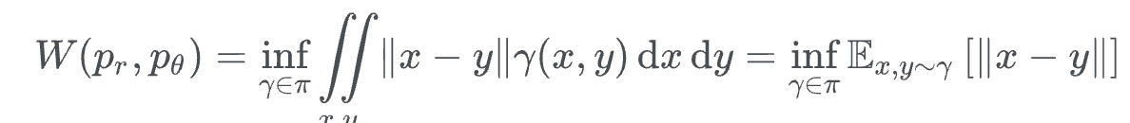
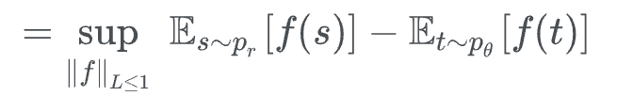
Kantorovich Rubenstein Duality
In the continuous setting, we get a related distance called Wasserstein distance
This is just a function with the same domain as the probability distributions that has to be maximized!
This version does not need a linear program.
Does not give a transport plan!

Slide 32
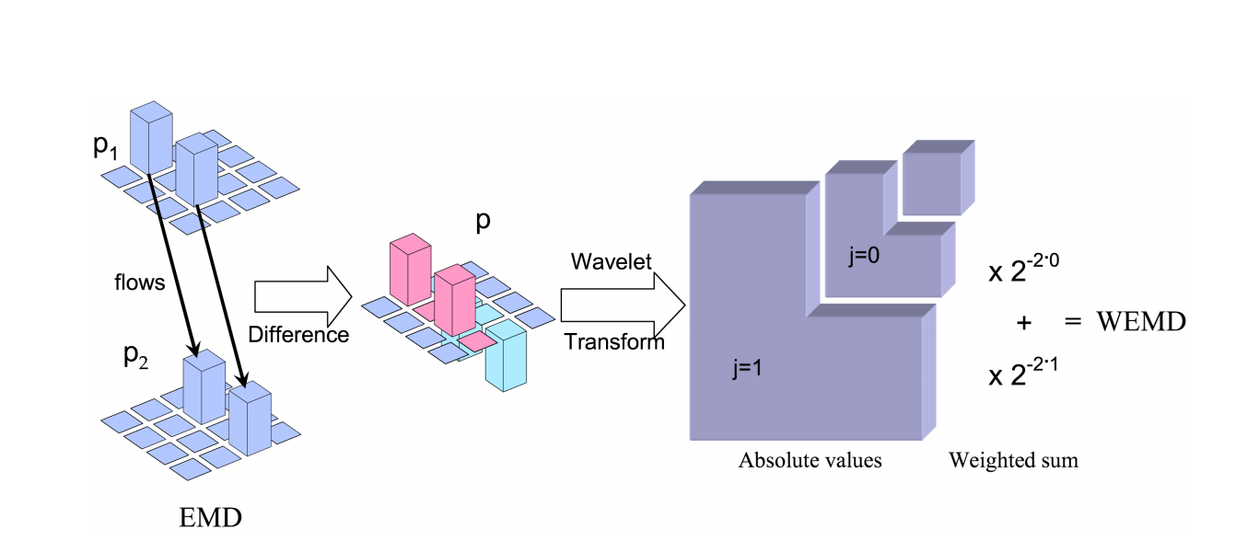
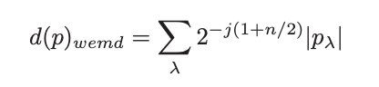
Computing EMD with the Dual Form
Take the difference of two histograms and use a wavelet basis to represent them
Since wavelets are a rich basis the wavelet transform is an approximation of f

Slide 33
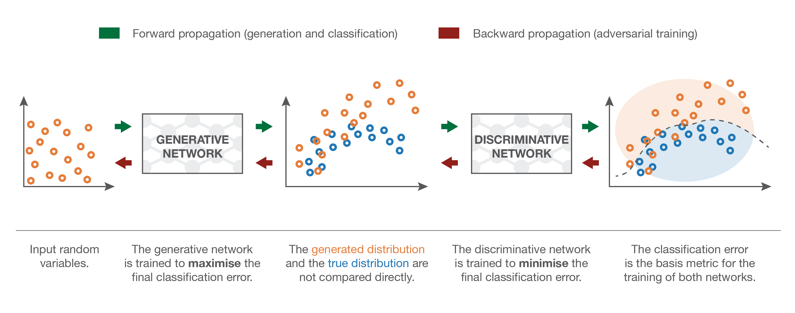
GAN
Discriminator classifies between real and fake examples

Slide 34
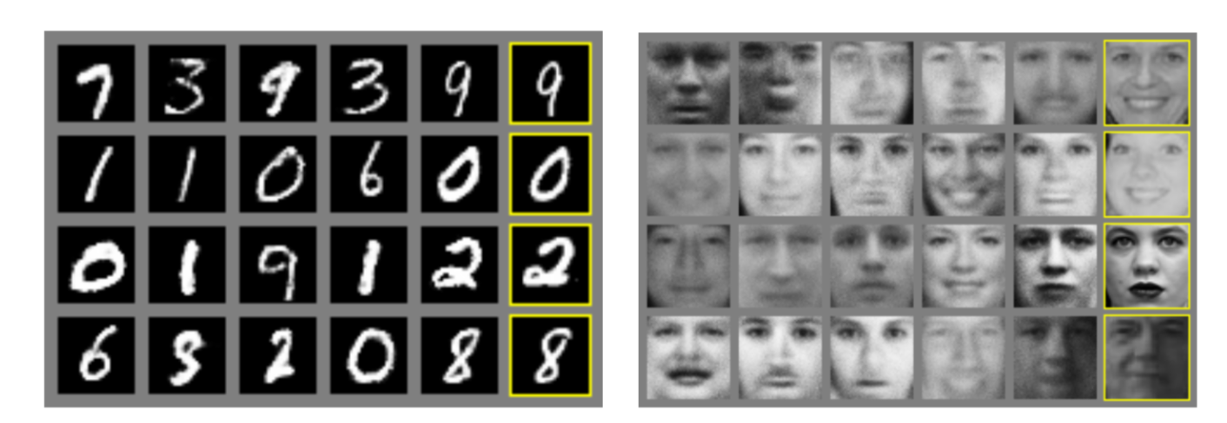
Generated Examples

Slide 35
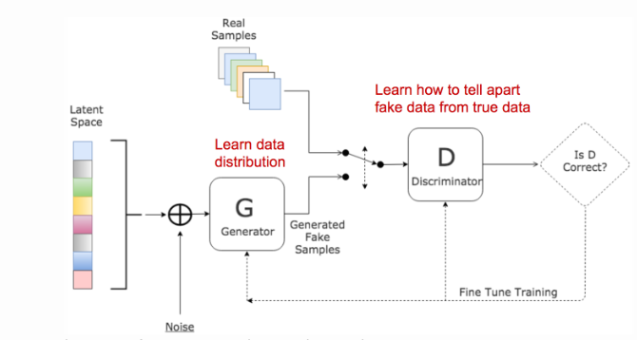
Generative Adversarial Network
Goodfellow et al. 2014

Slide 36
2 Networks
Generator: takes random noise and transforms into sample from target distribution
Discriminator: discriminates between generated (“fake”) examples and real examples
The two networks play a minimax game
Indirect way of matching distributions

Slide 37
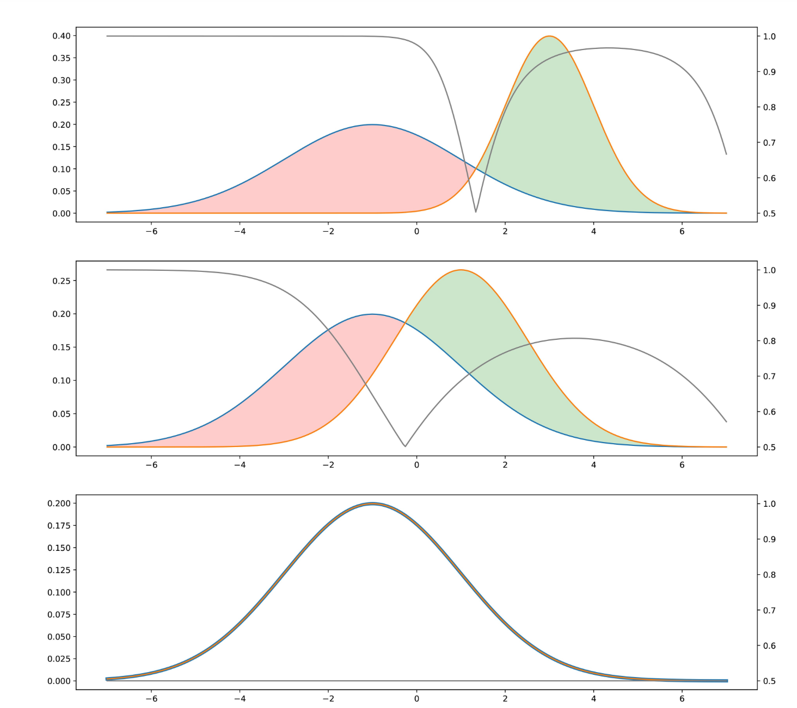

Slide 38
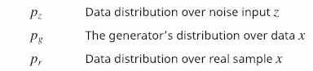
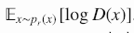
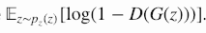
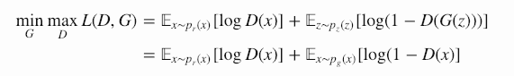
GAN Loss function
Maximize Discriminator’s answer. (1) on real samples
Maximize Discriminator’s answer (0) for fake samples
Minimax game: Generator wants discriminator to perform badly

Slide 39
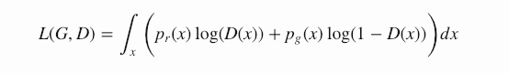
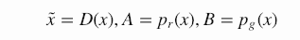
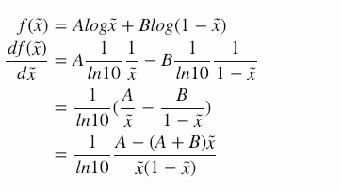
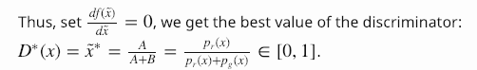
Optimal Discriminator Behavior

Slide 40
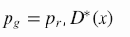
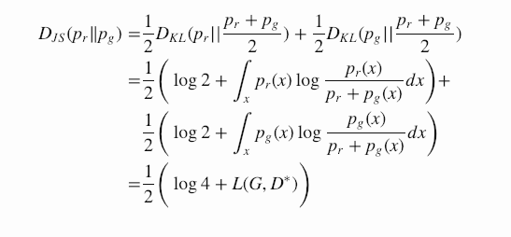
Discriminator computes JS Divergence
When generator is optimal
When both G and D are optimal D loss is -2 log 2 (otherwise known as ½)
According to formula for JS Divergence
Thus the discriminator converges to a JS divergence between the samples

Slide 41
Jensen-Shannon Divergence
KL Divergence
JS divergence

Slide 42

GANs
The JS describes the equilibrium point
But that doesn’t mean we will get there
Why?
From the derivative of $log⁡(u)$
With $u = 1 – sigmoid(D(G(z)))$

Slide 43

Problems with GANs 1: Small gradients when generator is bad
When generated data is very far from training data the two distributions are far away discriminator can be very good
Small gradients, generator does not know how to change itself to learn well

Slide 44


Vanishing Gradients
From the derivative of $log⁡(u)$
With $u = 1 – sigmoid(D(G(z)))$
What happens when D is very confident a point is fake?
$σ=sigmoid(D(G(z)))$ is small
$σ^{′}$ is small
This term goes to zero ( $\frac{1}{1 −0}⋅0$ )
Vanishing gradients!
Generator cannot improve

Slide 45


Alternative minimization
This observation motivated an alternate objective for $G$ to minimize:
Instead of the first term in gradient being $\frac{1}{1−σ}⋅−σ′$ it is now $\frac{1}{σ}⋅σ′$
$\frac{1}{σ}$ and $σ′$ diverge as they approach 0, leading to non-vanishing gradients

Slide 46


GANs
Minimax (blue line) has extremely small gradient when D is confident the point is fake (left half, $σ≈0)$
This is bad because that is precisely when $G$ need gradient signal most
Non-saturating (red line) has extremely small gradient when D is confident the point is real (right half, $σ≈1)$
Not bad, because this isn’t the term $D$ is optimizing for fake points

Slide 47

GANs
$G$ receives largest signal when $D$ thinks points are fake
$D$ receives largest signal when it thinks fake points are real

Slide 48
GANs
GANs can generate sharper images generally
Do not need to explicitly define distribution distances
Unfortunately, learning GANs with neural networks can be difficult in practice
Convergence to equilibrium is not guaranteed
Equilibria for minimax game are saddle points
Notes:
NN are not convex generally

Slide 49

Wasserstein GAN [Arjovsky et al. 2017]
Uses Wasserstein metric instead of JS
Distance between manifolds with disjoint support

Slide 50


Distances on parallel lines
KL Divergence:
JS Divergence:
Same value independent of distance between lines!

Slide 51

Wasserstein on Parallel Lines
Matches with intuition of moving dirt.
Wasserstein distance can be better when the supports of
the two probability distributions are far away.
This can occur when generated data is far from training data

Slide 52


Wasserstein Distance by Discrimnator
Instead of the Discriminator giving a decision “0” for fake data but “1” for real data gives a value of a function f
The witness function f can be estimated by the Discriminator
The Discriminator would output a low value for fake samples and high value for real data
This function has to be lipschitz continous (can’t be jagged) has to vary smoothly
Kantorovich-Rubenstein duality:

Slide 53
WGAN In practice
Takes off sigmoidal decision layer
After every gradient update to the witness function f, clamp weights to a small fixed range
New loss function does not have logarithm, just difference of expected values

Slide 54

Improves vanishing Gradient

Slide 55

Problem 2: Vanishing gradient for generator when discriminator gets good

Slide 56

Problem 3: Mode Collapse

Slide 57


Improvements in Training GANs
Feature matching
Optimize the discriminator to inspect whether the generator’s output matches the statistics of real samples, i.e., does the generated mean equal the real mean?
Minibatch discrimination
Take the batch as a whole instead of one input at a time and learn relationships between pairs of samples

Slide 58


GANs
Can learn well with carefully selected model architectures
Radford et al. (2015): deep convolutional GAN (DCGAN)
Generated images of bedrooms
Can break the generation process into many levels
Can learn to sample from conditional distributions
Train a series of conditional GANs to first generate low-res versions and then incrementally add details
Denton et al. (2015): LAPGAN
Generated images of churches
Notes:
LAPGAN fooled human observers pretty well as well with subjects identifying up to 40% of the generated samples as being real

Slide 59
Further reading
Goodfellow et al., Section 20.10.4
Lectures on GANs CS 11-785 at CMU
https://lilianweng.github.io/lil-log/2017/08/20/from-GAN-to-WGAN.html
https://wiseodd.github.io/techblog/2017/01/26/kl-mle/
Goodfellow et al 2014 paper
Arjovsky et al 2017 paper

